Slide 1
How to make plots with ggplot
Barry DeCicco (bdecicco2001@yahoo.com)
Ann Arbor R Users’ Group Meeting
October 18, 2022

Slide 2
Contents

Slide 3
What is GGPlot?
Ggplot2 is an R package developed by Hadley Wickham, based on the ‘grammar of graphics’.
It can make plots which are very simple, or very complex.

Slide 4
Resources
The ggplot2 page of the tidyverse (https://ggplot2.tidyverse.org/, https://ggplot2.tidyverse.org/reference ).
The R Graph Gallery(https://r-graph-gallery.com) has many examples and code.
dplyr (https://dplyr.tidyverse.org/) for the data manipulations needed to make better graphs

Slide 5
Model of Operation
Invoke ggplot2, tell it which data set to use.
Tell it what columns to use for major elements (x-/y-axis, color, fill).
Tell it what to plot (points, lines, columns, etc.) with geom’s.
Then add features.

Slide 6
Run GGPlot
set.seed(1234567890)
histogram_data <- data.frame(value=rnorm(100),
group = sample(c("Group 1", "Group 2")))

Slide 7
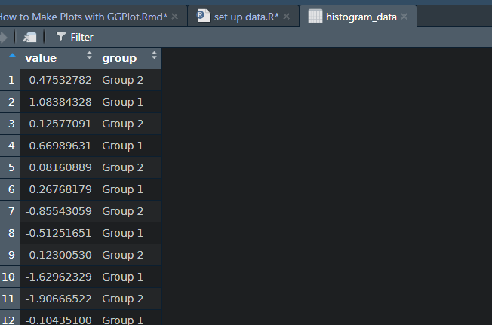
Data for Histogram

Slide 8
Example - Histogram
histogram_data %>% ggplot(., aes(x=value)) +
geom_histogram()
Translation: histogram data INTO
ggplot USE ‘value for the x value (no y value is needed)
Plot with a histogram.

Slide 9
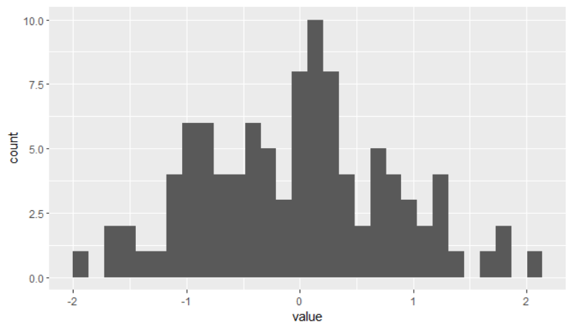
Results

Slide 10
Geoms
Geoms tell ggplot *what* to plot (bars, histograms, lines, etc.).
There are a lot of different geoms; they each have arguments and parameters.
They can perform statistical transformations (counts, means, loess smoothers).

Slide 11
Geom examples
geom_bar(), geom_col() (bar charts)
geom_errorbarh(), geom_boxplot(), geom_violin()
geom_density()
geom_label(), geom_text().
See: https://ggplot2.tidyverse.org/reference/ for more.

Slide 12
Variations
Other variables can be displayed, in many ways:
Color by group
Plotting symbols differing by group.
Break up the graph by group

Slide 13
Example – Color by Group
histogram_data %>% ggplot(., aes(x=value)) +
geom_histogram()
Translation: histogram data INTO
ggplot USE ‘value for the x value (no y value is needed)
Plot with a histogram.

Slide 14
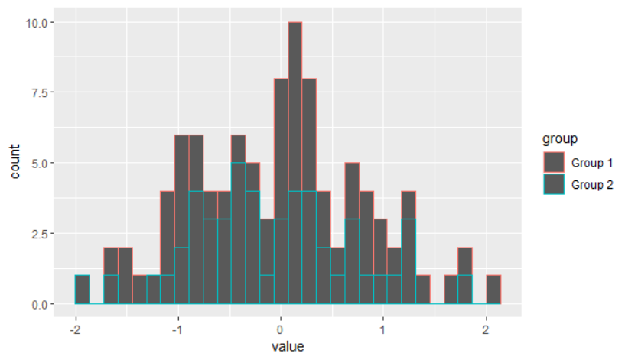
Results – Not So Good

Slide 15
Cure – Break things up by group
You can add ‘layers’ to a ggplot:
ggplot(data, aes(…) +
geom_XXX() +
geom_YYY() +
many, many things.

Slide 16
Cure – Break things up by group
facet_wrap(), facet_grid() will break a plot into sub-plots.
These are sometimes called ‘small multiples’, where x*y is broken into subplots based on z (sometimes by multiple variables).

Slide 17
Cure – Break things up by group
facet_wrap(), facet_grid() will break a plot into sub-plots.
These are sometimes called ‘small multiples’, where x*y is broken into subplots based on z (sometimes by multiple variables).

Slide 18
Break plot by group
histogram_data %>% ggplot(., aes(x=value)) +
geom_histogram() +
facet_wrap(~group)
This adds an additional layer onto the plot, which forms it into subplot.
[multiple variable and row/column arrangements can be specified]

Slide 19
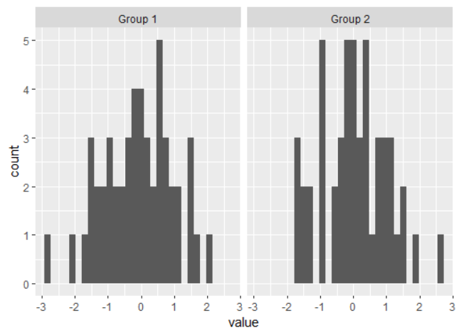
Results

Slide 20
Tidy data
ggplot adheres to the tidyverse’s principle of ‘tidy data’:
Every column is a variable.
Every row is an observation.
Every cell is a single value.
[https://cran.r-project.org/web/packages/tidyr/vignettes/tidy-data.html]

Slide 21
Long vs wide data
ggplot works best with data in the ‘long’ vs ‘wide’:
For example, a given type of value comes from one column, not multiple columns.
There are other columns which define who, what when, where the value came from.
This is usually seen in longitudinal data.
[https://cran.r-project.org/web/packages/tidyr/vignettes/tidy-data.html]

Slide 22
Advantage of Long data
ggplot can take one or a few numeric columns, and use several ‘slicing’ columns to restructure the data into the particular structure needed to

Slide 23
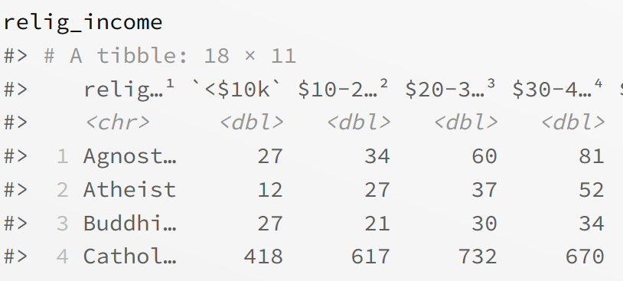
Example of Wide data
Note that a column of information (income) is stored in the column names.
It is less usable there.
[From: https://tidyr.tidyverse.org/articles/pivot.html ]

Slide 24
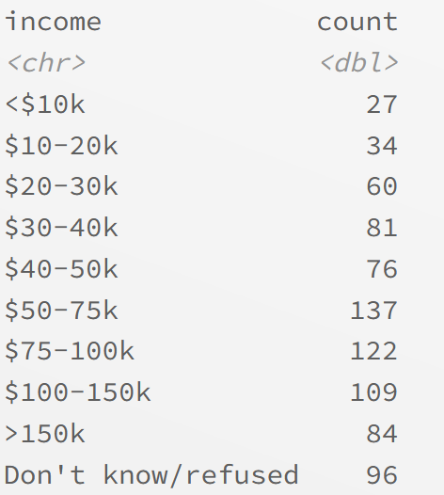
Example of Long data
Income is now more usable – the original data set can be built as a table; histograms are easy.
How to convert?

Slide 25
The tidyr package’s pivot_longer() and pivot_wider()
Pivot_longer() converts wide to long.
Pivot_wider() converts long to wide.
https://tidyr.tidyverse.org/articles/pivot.html

Slide 26
Pivoting the religion Data set
relig_income %>%
pivot_longer(!religion, names_to = "income", values_to = "count")
‘religion’ was not included; it was to go from being a row label to a label for groups of rows.
The values were to come from the remaining columns of the df; the commands.
‘names_to’ said what to do with the column names (put in a column named ‘religion’.
‘values_to’ said what to name the column with the values (put in a column named ‘count’).
https://tidyr.tidyverse.org/articles/pivot.html

Slide 27
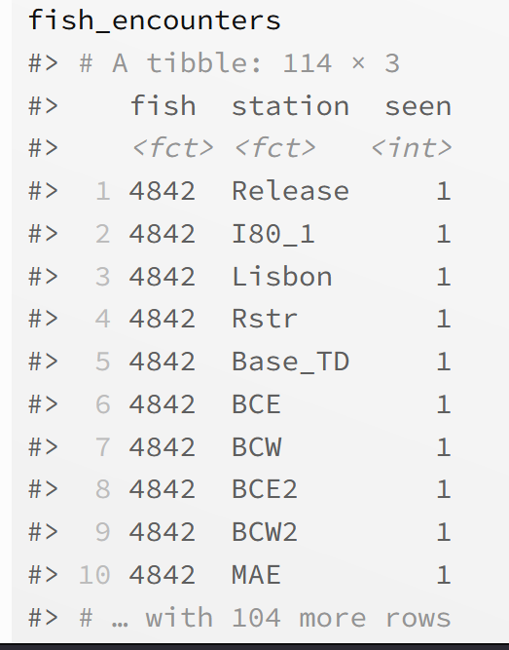
Pivoting A long Data Set to Wide
This has multiple rows per fish.
The column ‘fish’ becomes a single row’s label.
There are several stations per fish; they will go to column headings.
The ‘seen’ variable will be aggregated into counts.
https://tidyr.tidyverse.org/articles/pivot.html

Slide 28
Pivoting A long Data Set to Wide
fish_encounters %>% pivot_wider(names_from = station, values_from = seen)
‘fish’ was not included; it was to go from being a label for groups of rows to a row.
The values were to come from ‘seen’.
‘names_to’ said what to put into the headers (values from the column ‘station’).
https://tidyr.tidyverse.org/articles/pivot.html

Slide 29
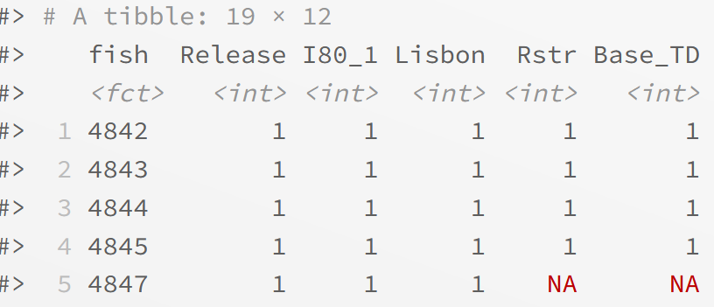
REsults
Note that NA’s were created to fill in blanks.
https://tidyr.tidyverse.org/articles/pivot.html

Slide 30
Preparing the data set for the big plot
This is a synthetic data set on ER admissions, pre- and post-COVID. It is totally made up from scratch, and has nothing to do with any hospital data that I have ever seen.
It is almost ready to graph, but is not quite in long form – the counts for ‘COVID’ and ‘Other’ causes of admission are in separate variables.
Let’s pivot……………………..

Slide 31
Preparing the data set for the big plot
This is a synthetic data set on ER admissions, pre- and post-COVID. It is totally made up from scratch, and has nothing to do with any hospital data that I have ever seen.
It is almost ready to graph, but is not quite in long form – the counts for ‘COVID’ and ‘Other’ causes of admission are in separate variables.
Let’s pivot……………………..

Slide 32
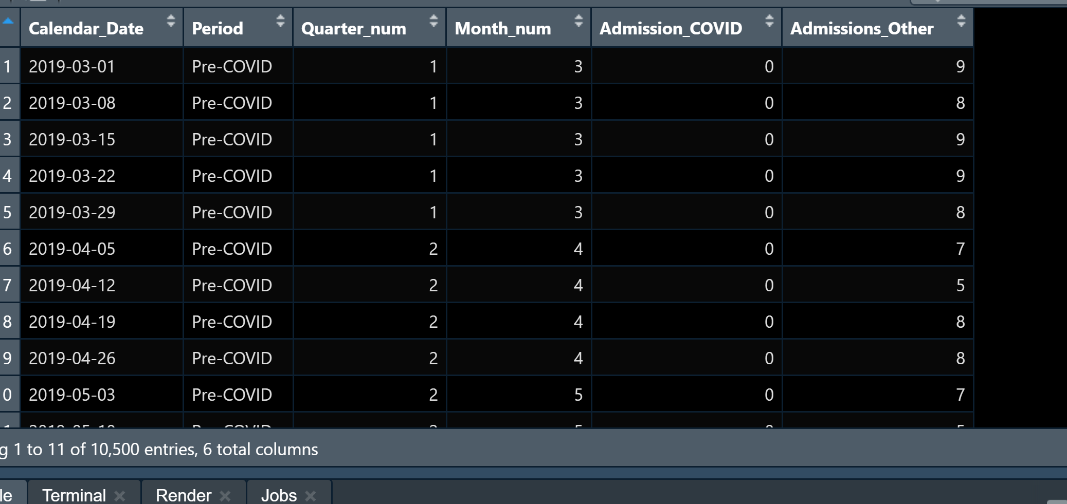
Before – Wider Data
It’s partially wide, but the COVID and other admission rates are in separate columnms

Slide 33
Command
ER_Long_df <- ER_df %>% pivot_longer(
!c(Calendar_Date, Quarter_num, Period, Month_num),
names_to = "Cause",
values_to = “Count")
Use Calendar_Date through ‘Month_num’ to label groups of rows.
Put the column names ‘Admission_Covid’ and ‘Admission_Other’ into the values in column ‘Cause’.
Put the values from those two columns into a value ‘Count’.

Slide 34
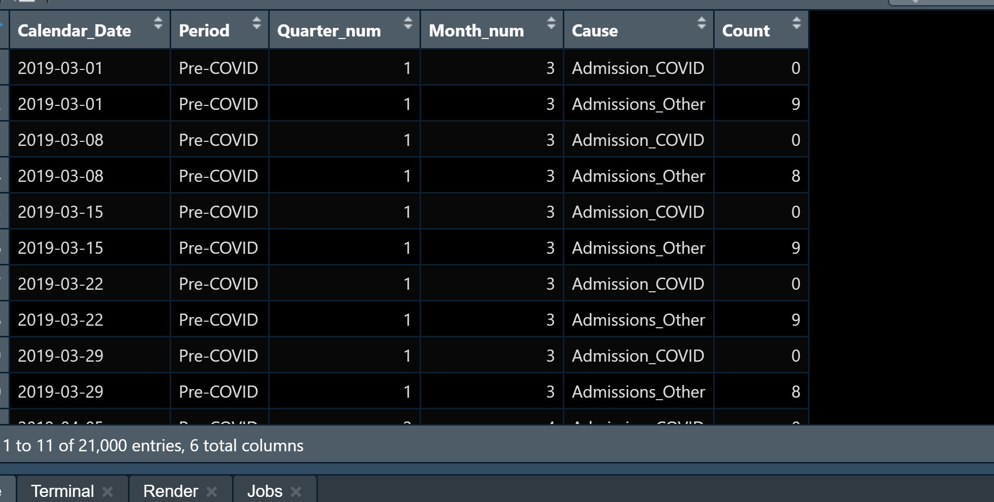
After
The numeric values to be plotted are all in ‘count’.
All other variables are treated as ‘slicing’ variables.

Slide 35
Now, Plot the data
The goal is to compare the admission counts for COVID and all other causes (combined), over time.
The counts are by week.
There is a variable, ‘Period’, which defines the pre-/post-COVID time periods.
The variable ‘Cause’ defines which counts were for COVID admissions and which were from other causes.

Slide 36
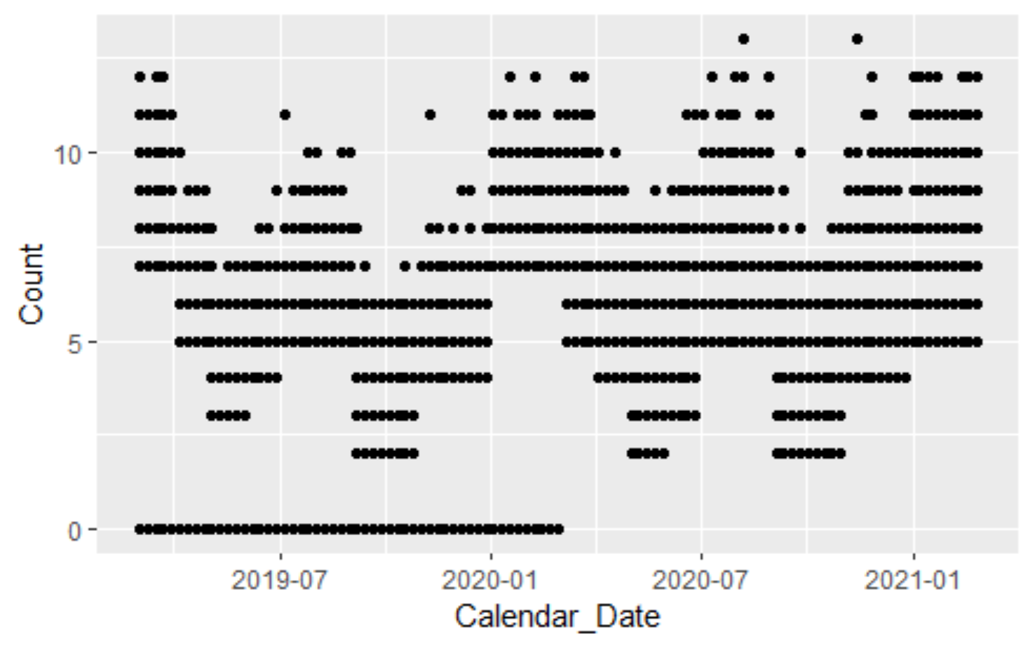
First plot
ER_Long_df %>%
ggplot(.,aes(x=Calendar_Date, y=Count, weight= Count)) +
geom_point()
The x values are from ‘Calendar_Date’
The y values are from ‘Count’.
Plot points.

Slide 37
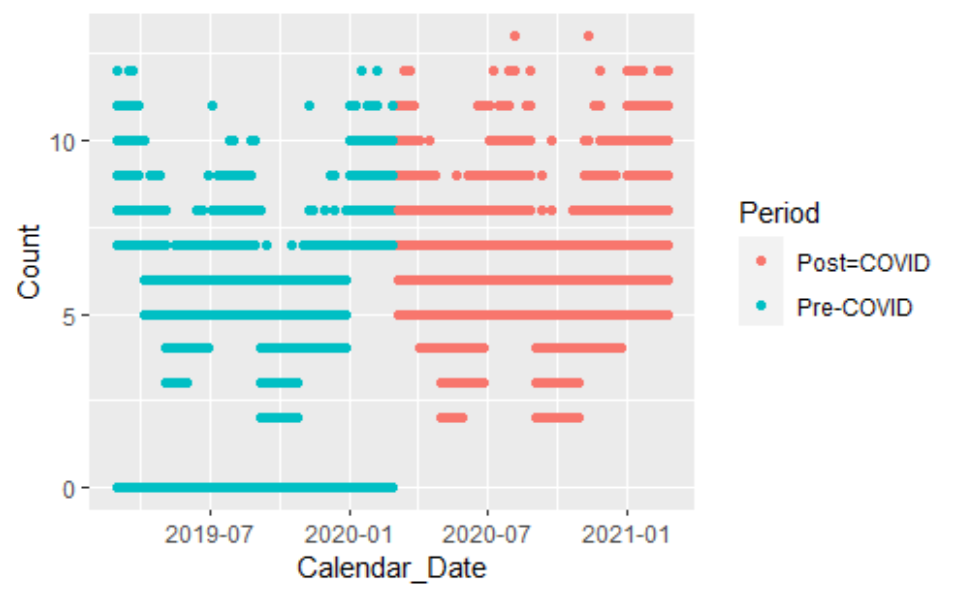
Second plot – Color by Pre/Post-COVID
ER_Long_df %>%
ggplot(.,aes(x=Calendar_Date, y=Count, weight= Count,
color = Period)) +
geom_point()
The x values are from ‘Calendar_Date’
The y values are from ‘Count’.
Plot points.
Color by period.

Slide 38
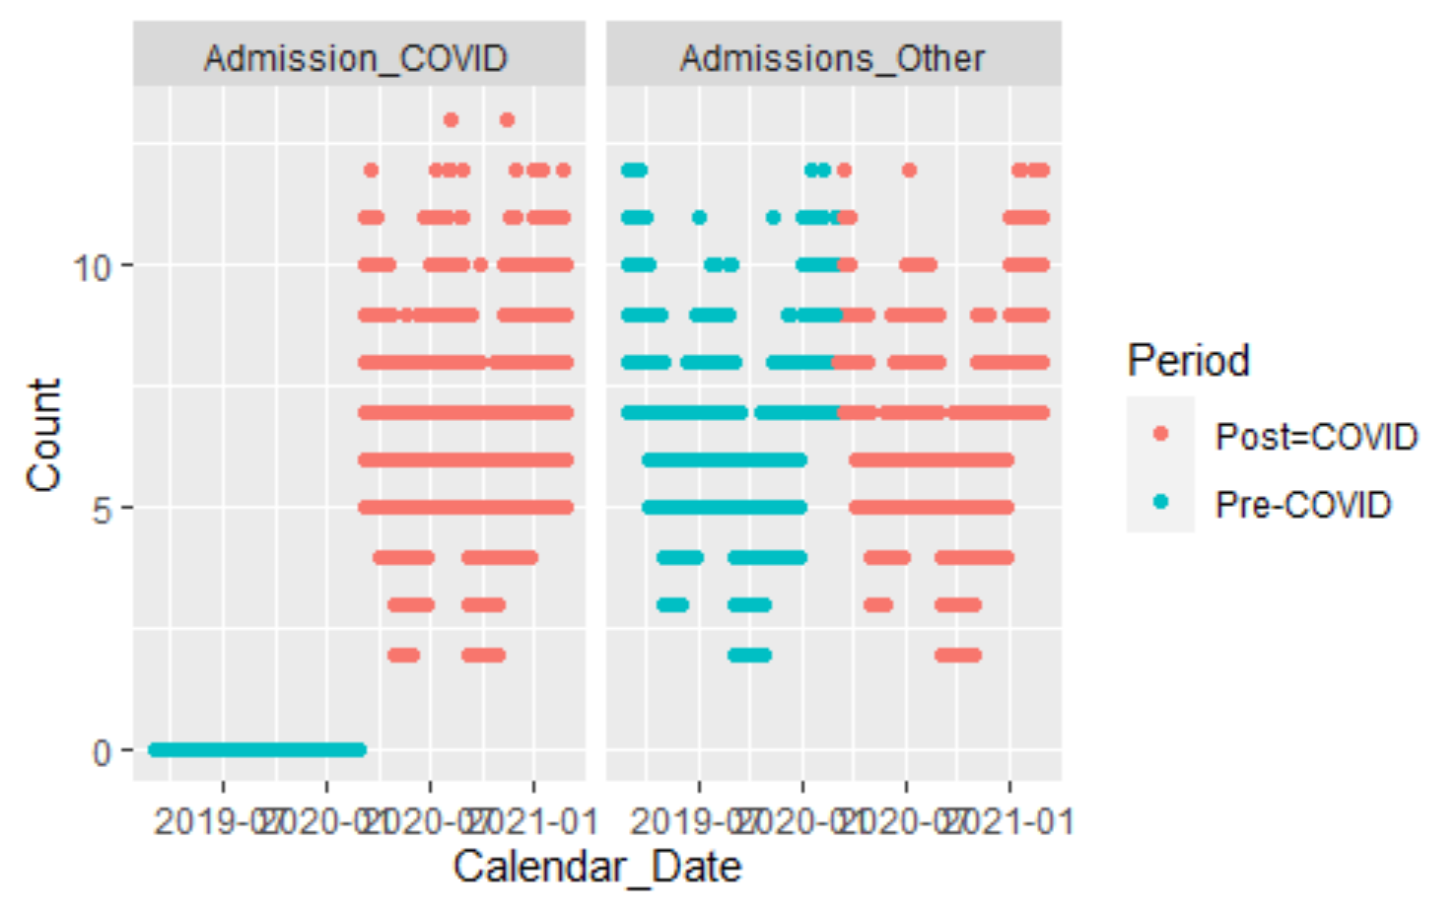
Third plot – split by cause
ER_Long_df %>%
ggplot(.,aes(x=Calendar_Date, y=Count, weight= Count,
color = Period)) +
geom_point() +
facet_wrap(~Cause, nrow = 1)
The x values are from ‘Calendar_Date’
The y values are from ‘Count’.
Plot points.
Color by Period.
Subplot by Cause.

Slide 39
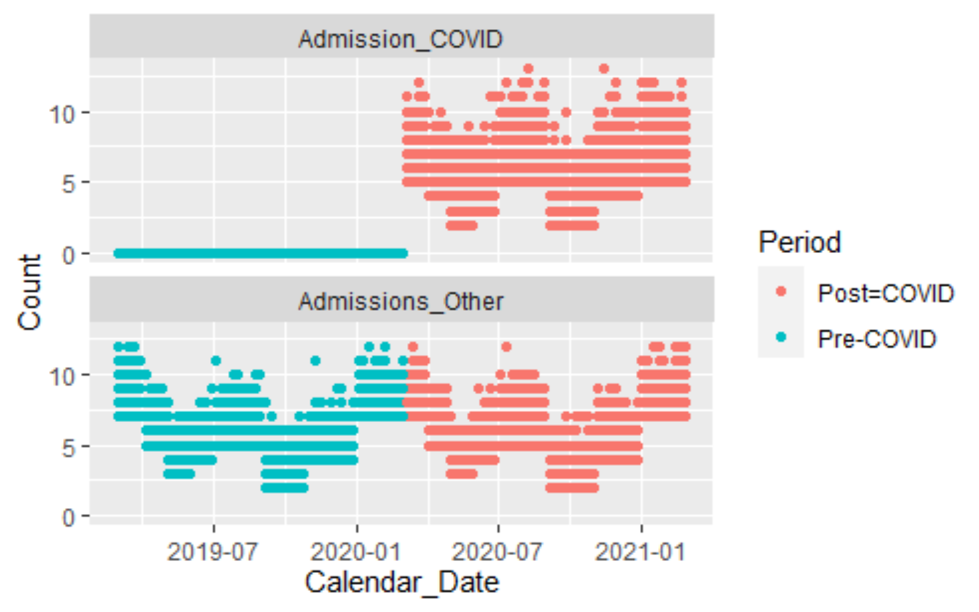
Third plot – split The other way by cause
ER_Long_df %>%
ggplot(.,aes(x=Calendar_Date, y=Count, weight= Count,
color = Period)) +
geom_point() +
facet_wrap(~Cause, nrow=2)
The x values are from ‘Calendar_Date’
The y values are from ‘Count’.
Plot points.
Color by Period.
Subplot by Cause.

Slide 40
Final Plot, with Bells and Whistles
ER_Long_df %>%
ggplot(.,aes(x=Calendar_Date, y=Count, weight= Count,
color = Period)) +
geom_point() +
facet_wrap(~Cause, nrow = 2)+
ggtitle("ER Visit Counts by Week, COVID/All Others, Pre-/Post-COVID") +
ylab("Weekly Admission Rate") +
xlab("ED Arrival Date (Week)") +
theme(axis.text.x = element_text(angle = 90)) +
# theme(legend.position = c(0.2, 0.2)) +
scale_x_date(date_breaks = "months")

Slide 41
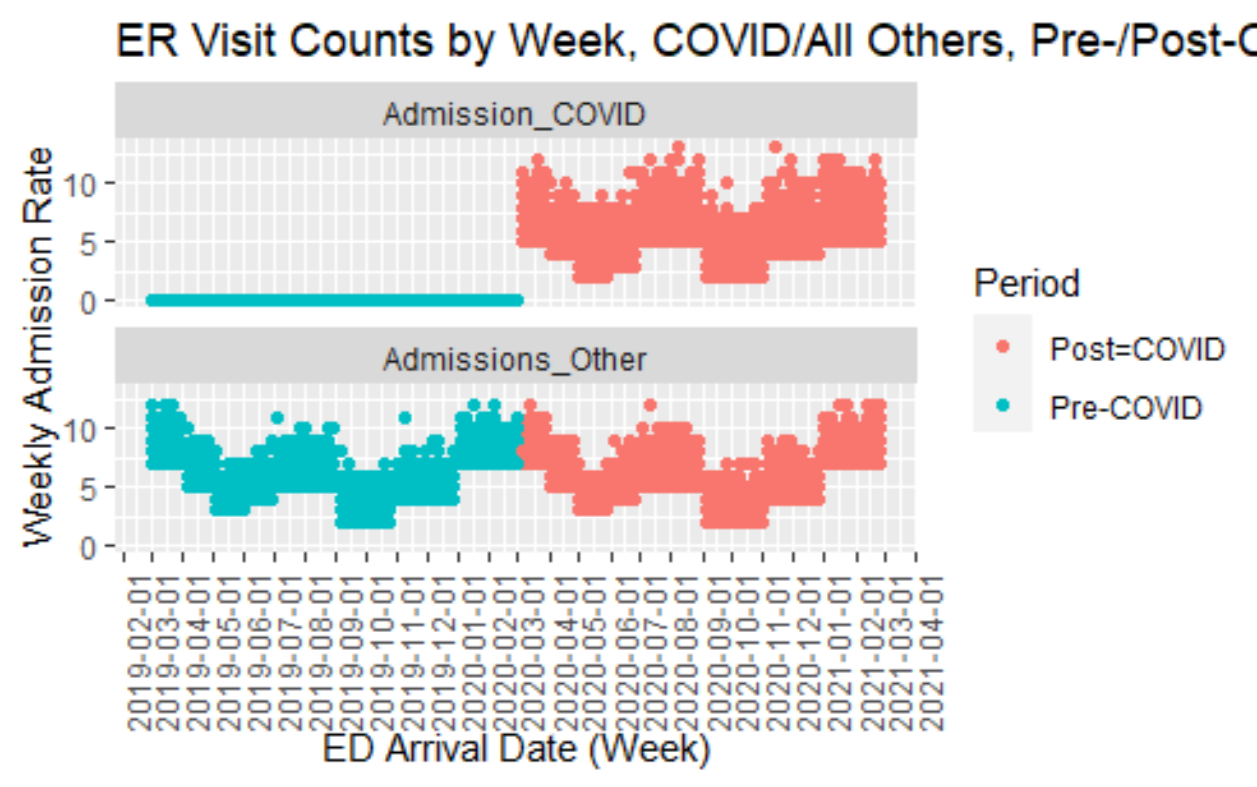
Final Plot, with Bells and Whistles

Slide 42
Questions?

Slide 43
Resources
The ggplot2 page of the tidyverse (https://ggplot2.tidyverse.org/, https://ggplot2.tidyverse.org/reference ).
The R Graph Gallery(https://r-graph-gallery.com) has many examples and code.
Dplyr, for the data manipulations needed to make better graphs: https://dplyr.tidyverse.org/
The reference for ggplot2: https://ggplot2.tidyverse.org/reference
Pivotting: https://tidyr.tidyverse.org/articles/pivot.html
Tidy Data: https://cran.r-project.org/web/packages/tidyr/vignettes/tidy-data.html

